Slide 1
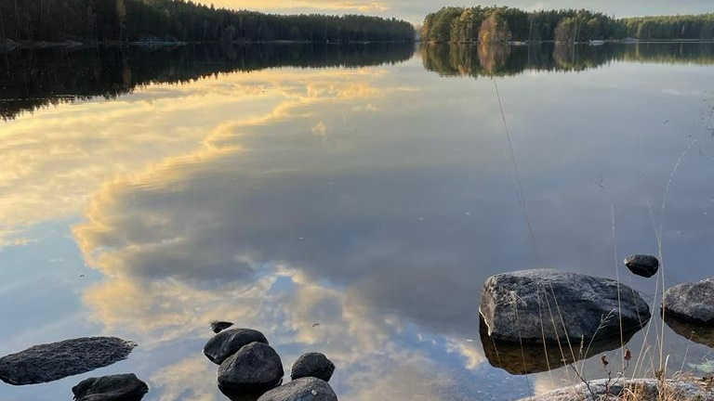
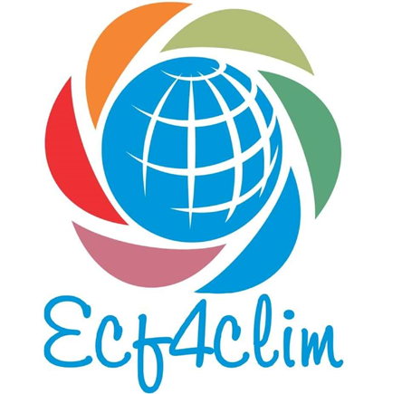
ROADMAP FOR SUSTAINABILITY EDUCATION
Notes:
This is a roadmap for sustainability education: The aim is to give ideas How to proceed and what needs to be considered in development of sustainability education at schools, universities and other educational organisations?
The roadmap for sustainability education has been created as part of ECF4CLIM research
In this presentation we shortly introduce the background and present each step of the roadmap,

Slide 2
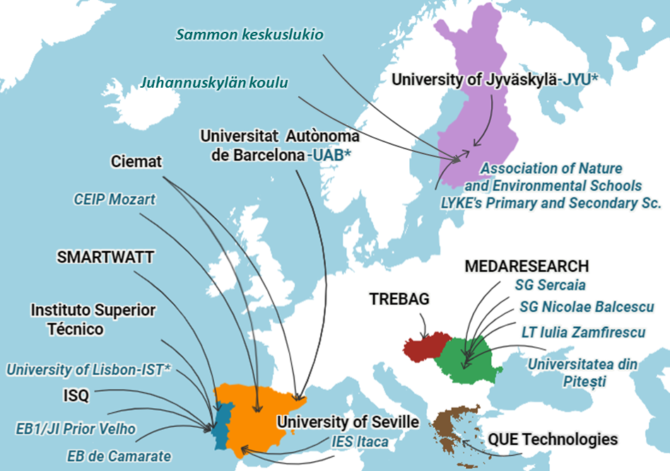
1.10.2021 – 30.9.2025
Green Deal
Horizon 2020
Climate change mitigation and sustainability in education
Competences!
This project has received funding from the European Union's Horizon 2020 research and innovation programme under grant agreement No 10103650.
A EUROPEAN COMPETENCE FRAMEWORK FOR A LOW CARBON ECONOMY AND SUSTAINABILITY THROUGH EDUCATION
Notes:
ECF4CLIM project is a four-year international EU project. ECF4CLIM has partner countries, schools, and universities in Spain, Finland, Portugal and Romania, and technical partners in Hunagary and Greece.
ECF4CLIM has gained funding from European Union's Horizon 2020 research and innovation programme. and it is a part of European GreenDeal. The main aim is to promote climate change mitication and sustainability competences in education in Europe.

Slide 3
GreenComp
GREEN COMP
COMPETENCE AREAS
VALUES
ACTION
COMPLEXITY
VISIONS
a reference framework for sustainability competences.
part of the policy actions by EU
identifies a set of sustainability competences -knowledge, skills and attitudes
See the documents:
https://ec.europa.eu/jrc/en/greencomp
https://ec.europa.eu/jrc/en/greencomp/greencomp-conceptual-reference-model
COMPETENCES
KNOWLEDGE, SKILLS AND ATTITUDES
K
S
A
K
A
K
A
A
K
A
A
A
K
S
K
A
K
S
A
S
S
S
K
S
S
K
S
K
S
S
A
K
A
S
K
A
Notes:
The aim of the roadmap is to further develop the sustainability competences outlined in GreenComp - the European sustainability competence framework, developed by the Joint Research Center of the European Commission (Bianchi & al. 2022).
The GreenComp is one of the policy actions set out in the European Green Deal as a catalyst to promote learning on environmental sustainability in the European Union. GreenComp identifies a set of sustainability competences -knowledge, skills and attitudes.
The picture here explains how GreenComp includes four competences areas and each of them consist of four competences that cover definitions of knowledge, skills and attitudes.

Slide 4
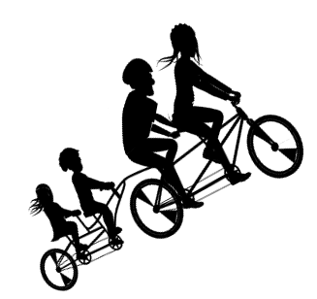
VALUING
SUSTAINABILITY
ENVISIONING SUSTAINABLE
FUTURES
EMBODYING SUSTAINABILITY VALUES
FUTURES LITERACY
SUPPORTING
FAIRNESS
ADAPTABILITY
EXPLORATORY THINKING
PROMOTING NATURE
GreenComp
SYSTEMS THINKING
INDIVIDUAL INITIATIVES
EMBRACING
COMPLEXITY
CRITICAL THINKING
COLLECTIVE ACTION
ACTING FOR SUSTAINABILITY
PROBLEM FRAMING
POLITICAL
AGENCY
Notes:
Here you can see the four competence areas of GreenComp Embodying sustainability values, Embracing complexity in sustainability, Envisioning sustainable futures and Acting for sustainability. The roadmap is structured according to these four competence areas. /
The competence area ‘Embodying sustainability values’ focus on reflect on and challenge prevaling values and world-views in terms of unsustainability > Supporting fairness refers to advocating equity and justice for current and future generations and learning from previous generations
> Promoting nature means promoting planetary wellbeing. Promoting nature requires knowledge about ecosystems and the main parts of the natural environment (geosphere, biosphere, hydrosphere, cryosphere and atmosphere)
Embracing complexity in sustainability empowers learners with systemic and critical thinking and problem framing skills. It encourages better assessing information and challenging unsustainability;
The competence area ‘Envisioning sustainability futures’ enables learners to visualise alternative future scenarios and identify actions to achieve a sustainable future. ‘Adaptability’ refers to a competence of coping with uncertainty about the futures and trade-offs in sustainability. Exploratory thinking, Applying creative and transdisciplinary approaches are essential in fostering sustainability solutions and innovations.
Acting for sustainability encourages learners to take action at individual and collective level to shape sustainable futures, to the extent possible. It also invites learners to demand action from those re
sponsible to make change happen.

Slide 5
CREATING THE ROADMAP FOR SUSTAINABILITY IN EDUCATION
ECF4CLIM-PROJECT
Spain Portugal Romania finland
ONLINE AND FACE-TO-FACE WORKSHOPS AND OTHER EVENTS
WE ARE HERE
TEACHERS
VARIOUS STAKEHOLDERS:
EXPERTS
ADMINISTRATION
RESEARCHERS
PRINCIPALS AND ADMINISTRATION
UNDERREPRESENTED COMMUNITIES
CROWDSOURCING DOCUMENT ANALYSIS
GREENCOMP
OPERATIONAL ENVIRONMENT
DEMONSTRATION SITES
INITIAL ROADMAP
EXPERT REVIEW
TESTING AND VALIDATING
International
+
WEEC 2022 WORKSHOP
EU GREEN WEEK EVENT
eDELPHI
ONLINE STAKEHOLDER DISCUSSION
Notes:
Additionally, the roadmap has been created on the basis of crowdsourcing process that invited wide audiences in discussions on enablers and constraints of sustainability education both in our partner countries and internationally. The roadmap draws also on a document analysis and literature review.
This roadmap will be further development at our demonstartion sites and valitated in the end of ECF4CLIm research project.

Slide 6
ROADMAP FOR SUSTAINABILITY EDUCATION
EMBODYING SUSTAINABILITY VALUES
EMBRACING
COMPLEXITY IN SUSTAINABILITY
ENVISIONING SUSTAINABLE
FUTURES
ACTING FOR SUSTAINABILITY
ENGAGEMENT
CONNECTIONS
VISIONS
ACTION
Why and how to promote sustainability?
How to frame the problem?
What are the possible futures in our context?
How to proceed?
Heikkinen, Nokkala, Lehtonen & Mykrä (2022) Based on GreenComp: The European sustainability competence framework (Bianchi, Pisiotis & Cabrera Giraldez 2022)
Notes:
Here is the basic structure of our roadmap: The roadmap consists of four interconnected phases: Engagement, Connections, Visions and Action.
(Promoting Engagement, Identifying Connections, Making visions for sustainable futures and action for sustainability.)
The roadmap consists of four steps.
The first step focuses on how to invite and engage people in sustainability in their private, study and future work life?
In order to engage they need knowledge about the importance of sustainability
And deliberative value reflection and inclusive dialogue on the values and meanings of sustainability. The aim of this step is to foster the emergence of a common understanding of sustainability and common good. It also establishes the principles for promoting fairness in collaboration.
The second step aims to find systemic connections of sustainability and their filed, work and everyday life
Additionally, it aims to promote critical thinking about the state of the environment, and the perspectives of different stakeholders.
The third step focuses on envisioning futures, adaptability, mapping possibilities for change and visions of a desirable future.
The fourth step aims at concrete action and evaluating the results. It is important to bear in mind that although each step emphasises a specific competence area of GreenComp, all four competence areas are intertwined at every step.

Slide 7
ROADMAP FOR SUSTAINABILITY EDUCATION
EMBODYING SUSTAINABILITY VALUES
EMBRACING
COMPLEXITY IN SUSTAINABILITY
ENVISIONING SUSTAINABLE
FUTURES
ACTING FOR SUSTAINABILITY
ENGAGEMENT
CONNECTIONS
VISIONS
ACTION
Why and how to promote sustainability?
How to frame the problem?
What are the possible futures in our context?
How to proceed?
Heikkinen, Nokkala, Lehtonen & Mykrä (2022) Based on GreenComp: The European sustainability competence framework (Bianchi, Pisiotis & Cabrera Giraldez 2022)
Notes:
Now we look closer at the first step of the roadmap

Slide 8
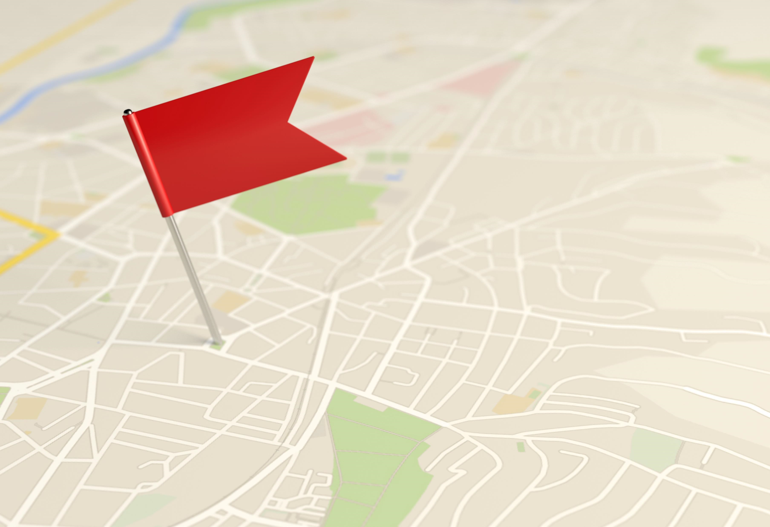
STEP 1 Engagement
How to engage people?
How to get on the same page?
VALUING
SUSTAINABILITY
EMBODYING
SUSTAINABILITY
VALUES
SUPPORTING
FAIRNESS
PROMOTING NATURE
Notes:
The first step of our roadmap is engagement. In the picture, you can see the corresponding areas of GreenComp.
The main question of this step is, why and how to promote sustainability. It is also important to get on the same page: what we are talking about, when we talk about sustainability. This engagement-step has three parts.

Slide 9
Step 1. Engagement
How to MOTIVATE AND activate?
Participatory approach
Time and space for dialogue and new ideas  will-formation and collaboration
Shared responsibility
Active role for students
identifying sustainability problems and investigating school’s environmental performance/impact
creating solutions
Notes:
First we should think, how to engage, motivate and activate all the people in our school or university. We need participatory approach. We need time and space to talk and discuss on these issues together. For motivation, it is essential to make people think themselves actively. What sustainability means to you? There should not be any right answers, but space for personal and shared reflection. We need to consider different people’s needs and perspectives to motivate them in collaboration and try to find common interests.
The aim is to share responsibility, no one alone can save the world!
We must let the students have an active role for example in identifying the problems and in mapping school’s environmental performance and impact and in creating solutions.

Slide 10
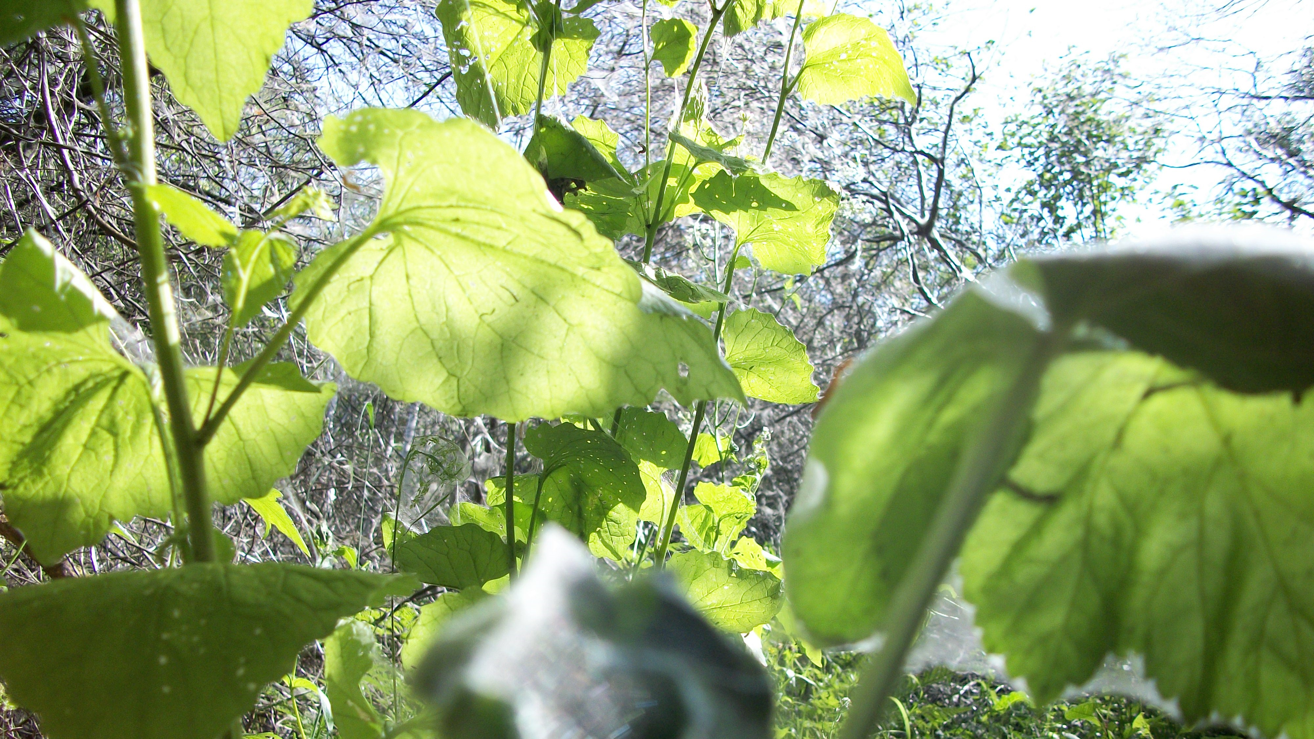
Step 1. Engagement
Why we must act?
Sustainability knowledge
Understanding the relevance and importance of sustainability
Planetary boundaries: human well-being is dependent on healthy ecosystems
Awareness raising campaigns, excursions - > shared experiences
Integrating sustainability in teaching all subjects, linking sustainability to the examples of one's own institution
Notes:
In order to get people engaged, we need to understand Why we must do something for the environmental issues, why to act? Knowledge about environment, sustainability and nature helps people to understand the importance of change.
The main point is to learn to consider planetary boundaries in all decisions. We the main point is to acknowledge how human well-being is dependent on healthy ecosystems and other species.
We need both awareness raising campaigns and inspiring excursions, where experiences are shared.
Sustainability needs also to be integrated in teaching in all subjects: what is the viewpoint to sustainability of different disciplines? What kind of examples of sustainability issues we have in our own institution?

Slide 11
Step 1. Engagement
respecting Different perspectives
Inclusive value reflection and dialogue
People need to experience themselves as accepted and welcomed to collaborate.
Together we are wiser!
Dialogue and inclusive decision-making on different levels
Use creative and interactive methods to practice value reflection and dialogue, e.g. drama games and roleplays
Notes:
Presumably, after discussions and awareness raising, there still exists different values and perspectives to sustainability.
In order to engage It is important to respect all these perspectives. People need to experience themselves as accepted and welcomed to collaborate. Therefore we need inclusive value reflection and dialogue.
Together we are wiser! Different ideas, needs and perspectives lead together to powerful and wise action.
So we need to focus on dialogue and democratic decision-making on different levels of the school or university
For example dramatic games and roleplays are such creative and interactive methods are good ways to learn and practice this.

Slide 12
ROADMAP FOR SUSTAINABILITY EDUCATION
EMBODYING SUSTAINABILITY VALUES
EMBRACING
COMPLEXITY IN SUSTAINABILITY
ENVISIONING SUSTAINABLE
FUTURES
ACTING FOR SUSTAINABILITY
ENGAGEMENT
CONNECTIONS
VISIONS
ACTION
Why and how to promote sustainability?
How to frame the problem?
What are the possible futures in our context?
How to proceed?
Heikkinen, Nokkala, Lehtonen & Mykrä (2022) Based on GreenComp: The European sustainability competence framework (Bianchi, Pisiotis & Cabrera Giraldez 2022)
Notes:
The second step on our roadmap is Connections.

Slide 13
STEP 2 Connections
SYSTEMS THINKING
How to frame the problem?
CRITICAL THINKING
EMBRACING
COMPLEXITY IN SUSTAINABILITY
PROBLEM FRAMING
Notes:
The second step asks how is this context, discipline, program, course or activity connected to sustainability and planetary wellbeing. Main question is, how to frame the problem – what is the issue we should work on and get better in our context? This step includes also three parts.

Slide 14
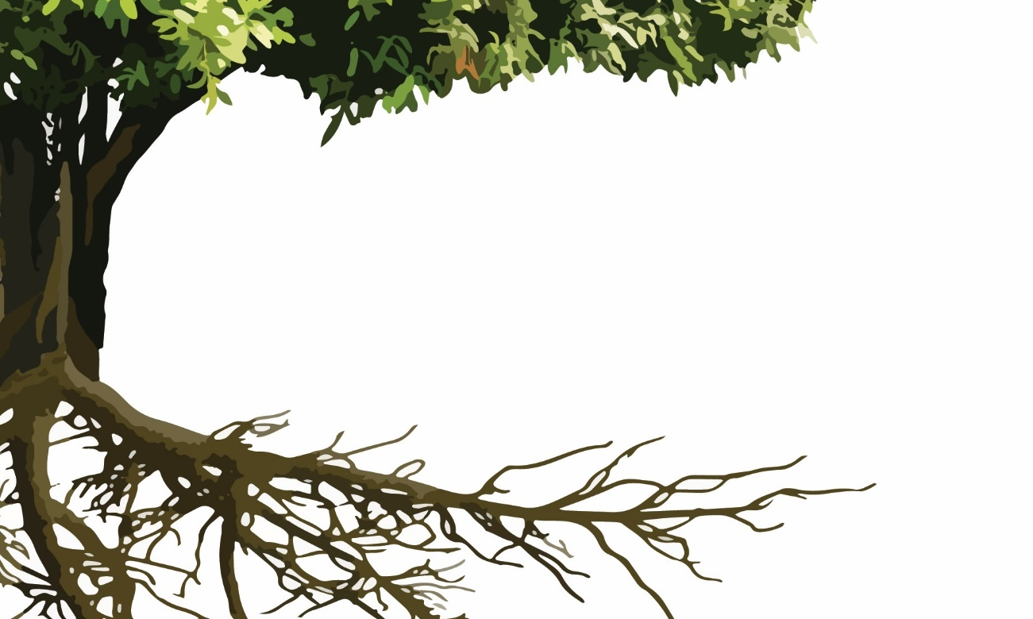
Step 2. connections
IT IS SO COMPLICATED!
COMPLEXITY AND ROOT CAUSES
… but finding root causes is inspiring and essential
Everything is connected to sustainability
Examples:
Systems thinking: Mind maps of connections, e.g. plastic
Cooperation with services/service providers (lunch, cleaning, recycling, electricity)
Pros and cons of technology
Notes:
Promotion of sustainability is complicated as sustainability is a complex issue. Everything is somehow connected to sustainability. Reflection on the root causes of environmental issues is essential. To improve systems thinking of connections, it is inspiring to make mind maps of the relations. We have a story included in our roadmap report how we are connected to the plastic in the oceans. At schools and universities, cooperation with relevant stakeholders for example lunch and cleaning services is essential: if the lunch services does not serve sustainable food because it is not available from wholesalers, the most accurate thing is to influence on wholesalers. Technology can help in promoting sustainability, but pros and cons of technology should be critically scrutinized.
.

Slide 15
Step 2. connections
Why DO we think as we think?
Underlying assumptions
In our school/ university, what are the unchallenged conventions in connection to sustainability?
Tools for challenging unsustainable conventions
Discussions on controversial issues, like eating meat or buying fast fashion (role play)
Critical consumerism, making “spoof ads” and memes
Studying history and different cultures widens our view
Notes:
Why do we think as we think? Our personal and collective assumptions, attitudes and cultural conventions can mislead us towards unsustainability. We shouldn´t be afraid of talking about controversial issues, like eating meat or buying fashion clothes, because in these discussions we can uncover underlying assumptions. For practicing critical thinking, spoof ads and memes are good resources and tools in teaching. Studying history and familiarising with different cultures widens our view. At the school or university context, studying could focus on the question of what are the unchallenged conventions that promote unsustainability?

Slide 16
Step 2. connections
Footprint and handprint of school
Current state of practice
Footprint: practices that generate negative impact to environment
Handprint: positive activities, like teaching and learning about sustainability
Mapping the most acute and significant issues, cooperation with stakeholders
Students as researchers
Measuring use of energy, water, and material consumption, recycling practices, scrutinizing the contents of teaching
Notes:
What kind of footprints and handprints our school or organisation have? Footprints consist of practices that generate negative impact to environment. While, some activities, like teaching about sustainability and decreasing negative practices, have a positive impact, positive handprint.
It is essential to map the most acute and significant issues. Students can take part in the work as researchers.
Mapping the footprint requires cooperation with stakeholders. To get the whole picture at school, it is useful to measure the use of energy and water, consumption, recycling practices, and also scrutinize the contents of teaching.

Slide 17
ROADMAP FOR SUSTAINABILITY EDUCATION
EMBODYING SUSTAINABILITY VALUES
EMBRACING
COMPLEXITY IN SUSTAINABILITY
ENVISIONING SUSTAINABLE
FUTURES
ACTING FOR SUSTAINABILITY
ENGAGEMENT
CONNECTIONS
VISIONS
ACTION
Why and how to promote sustainability?
How to frame the problem?
What are the possible futures in our context?
How to proceed?
Heikkinen, Nokkala, Lehtonen & Mykrä (2022) Based on GreenComp: The European sustainability competence framework (Bianchi, Pisiotis & Cabrera Giraldez 2022)
Notes:
I hope you all had good discussions. Now we go forward with our roadmap to step 3 and visions.

Slide 18
STEP 3 VISIONS
ENVISIONING
SUSTAINABLE
FUTURES
What are the possible futures in our context?
FUTURES LITERACY
ADAPTABILITY
EXPLORATORY THINKING
Notes:
This third step Visions focuses on envisioning possible futures in our context. Visioning futures strengthens adaptability and generates creative, exploratory thinking. This step includes also three points of view.
Kolmas askel keskittyy mahdollisien tulevaisuuksien kuvitteluun tässä oppilaitoksessa. Tulevaisuuden kuvittelu vahvistaa sopeutumiskykyä ja tutkivaa ajattelua. Myös tämä askel sisältää kolme näkökulmaa.

Slide 19
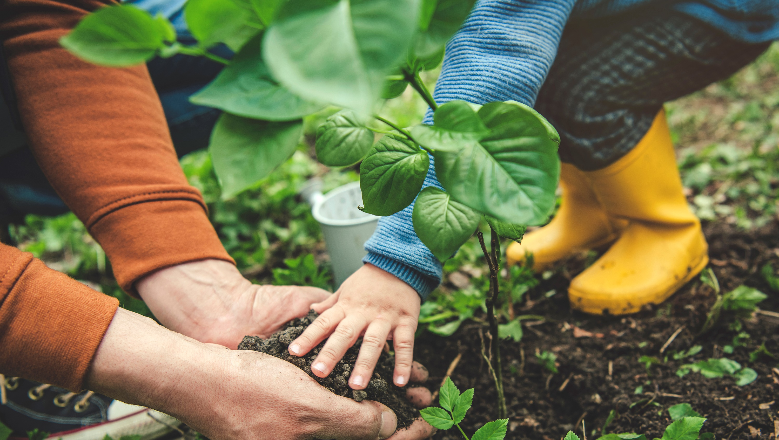
Step 3. visions
FUTURE IS IN OUR HANDS
ENVISIONING FUTURES
Our images have impact in behaviour and future
Where are we going? Creative visioning of probable and preferable futures
Mapping changes and trajectories that are needed in our context
What is our role in constructing sustainable futures?
Notes:
Vision together an ideal future, where you want to strive!
’To get forward with sustainability, we need to understand and take future in our hands! We need to acknowledge that our images and ways of thinking have impact in behaviour and future
Asking Where are we going? Is important. We need creative visioning. What kind of changes towards sustainability need to hapen in our context?
Future orientation is crucial for motivating people for sustainable changes and actions. It is essential to compare preferred futures with likely futures, what kind of future is expected based on the current trends and trajectories
and what kind of future we want to avoid and what we wish to strive for. Envisioning futures in the organizational context should build on the problem framing in the previous step of the roadmap. Visioning is important for creation of the strategy for action that is the following step of this roadmap.
How the furure is
How do we see the future and our role? How do we relate ourselves and take a stand for the future?
We need to understand what are the results, if we continue as usual. What are the possible futures?
What could be the ideal sustainable future?
What needs to be changed to achieve the sustainable future? What could be the possible routes to sustainability?
Suhde tulevaisuuteen:
Ensinnäkin on syytä tiedostaa, millainen tulevaisuus meillä on edessä, jos emme panosta kestävyyteen.
Sitten on tärkeää luoda visio kestävästä tulevaisuudesta, jotta tiedostamme, mitä tavoittelemme.
Sen jälkeen on syytä pohtia, mitä toimenpiteitä ja muutoksia meidän täytyy toiminnassamme tehdä, jotta edistämme kestävää tulevaisuutta emmekä vahvista epätoivottua tulevaisuutta.
The first step focuses on how to invite and engage people in sustainability in their private, study and future work life?
In order to engage they need knowledge about the importance of sustainability
And deliberative value reflection and inclusive dialogue on the values and meanings of sustainability. The aim of this step is to foster the emergence of a common understanding of sustainability and common good. It also establishes the principles for promoting fairness in collaboration.

Slide 20
Step 3. visions
making a change is not easy!
Emotional, cognitive and behavioral adaptability
What are the barriers and what helps us to adapt in changes?
Space for expressing concerns, comparing alternative solutions and outcomes, interventions
Consider different stakeholders emotions, attitudes, behaviour, and structures that are needed for change
Strengthening collective hope
Notes:
Encourage each other in change as change is not easy! We need to support ourselves and others
But making a change is not easy.
Change is possible only, if it happens on different levels of attitudes, cognition, behaviour, collective culture and organisation. We need to consider what are the barriers of sustainability and what could help to overcome the barriers?
We need also to consider different stakeholders emotions, attitudes, behaviour, and structures that are needed for change.
Thus, there needs to be organised time and space for expressing concerns, comparing alternative solutions and outcomes and for designing interventions.
The goal is to strengthen collective hope

Slide 21
Step 3. visions
Thinking out of THE box!
Exploration through creative and relational knowing
Complex problems demand creative solutions
Apply different ways of knowing (cognitive, critical, creative, and intuitive)
Cross-curricular, transdisciplinary knowing
Inquiry-based and phenomenon-based learning
Focus on real-life issues
Notes:
Visioning futures and creating solutions for complex issues demands creativity and thinking out of the box. Learning something that is not yet there. Quoting Einstein: problems can not be solved with the same thinking that have produced the problems.
We need to integrate different kinds of knowledge to address real life problems for example Inquiry-based and phenomenon-based learning, and transdisciplinary, crosscurricular approaches that integrate arts and science
Focusing on real-life issues is essential

Slide 22
ROADMAP FOR SUSTAINABILITY EDUCATION
EMBODYING SUSTAINABILITY VALUES
EMBRACING
COMPLEXITY IN SUSTAINABILITY
ENVISIONING SUSTAINABLE
FUTURES
ACTING FOR SUSTAINABILITY
ENGAGEMENT
CONNECTIONS
VISIONS
ACTION
Why and how to promote sustainability?
How to frame the problem?
What are the possible futures in our context?
How to proceed?
Heikkinen, Nokkala, Lehtonen & Mykrä (2022) Based on GreenComp: The European sustainability competence framework (Bianchi, Pisiotis & Cabrera Giraldez 2022)
Notes:
And here comes the last step, Action.

Slide 23
STEP 4 ACTION
How to proceed?
POLITICAL AGENCY
ACTING FOR SUSTAINABILITY
COLLECTIVE ACTION
INDIVIDUAL INITIATIVES
Notes:
Action is the core and goal of the whole roadmap process. But how to proceed? How to walk the talk? Without previous steps it is not possible to figure out the right and most effective way to promote sustainability, This step also includes three parts.

Slide 24
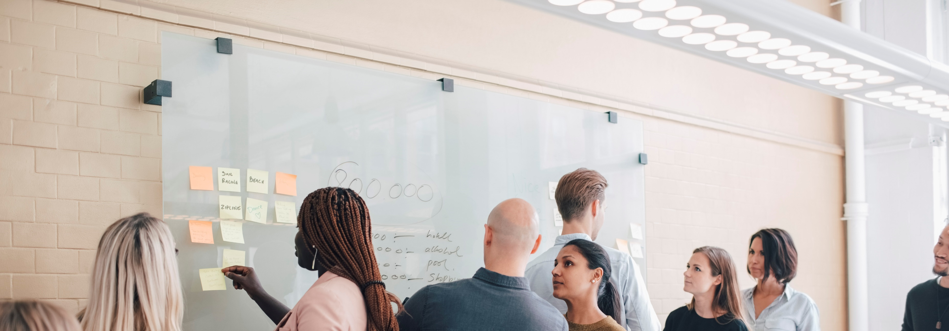
Step 4. action
Places for sustainable activity
Structures for change
Embedding sustainable practices in everyday life
Permanent structures for development (teams, timetable, administration, persons in charge of sustainability)
Defining authority and responsibilities - leaders’ crucial role
Learning to make an impact -> exercises for students
Notes:
First, there should be time and places for sustainability activities at school or university. However, unconnected, separate projects are easily forgotten after the project ends.
Thus, this means, some kind of planned stable structures for promotion of sustainability are needed.
New sustainable practices should be embedded in normal everyday life, that helps to engage everybody.. That enables permanent changes for sustainability –Activity for promoting sustainability is easier, if there are structures, like working teams, specific times in timetable for sustainability issues, rules for administration, and persons in charge of sustainability as facilitators of cooperation.
Defining power relations, authorities and responsibilities is important. Leaders have a crucial role in this work.
It is important to learn to influence on the infrastructures that are outside the school or university. This could be a good exercise for students to make change in the society, too.

Slide 25
Step 4. action
Well planned is half done
Action plan
Strategy and goals enable progressing proactively in the long term
Skills, knowledge, and attitudes evolve during the planning work
All previous steps, viewpoints and stakeholders should be included
Concrete participatory action: Who does what with whom, when, and with which resources
Notes:
Well planned is half done. So we need some kind of action plan.
Strategy and goals enable progressing in the long term.
Somebody may think that Planning processes is frustrating and bureaucracy - but in fact it is a part of the journey: skills, knowledge and attitudes develop during the planning work. To reach collective learning, everybody should be involved!
All previous steps and viewpoints should be included: The plan should be based on the engagement and values of people, on connections sorted out, metering of environmental performance and visioning of possibilities in this context.
The plan should make action concrete: Who does what with whom, when, and with which resources

Slide 26
Step 4. action
Money, time and wellbeing enable activity
Resources
To change, the school or university needs:
money for procurement or salaries,
time for planning and action,
pedagogical tools and models.
Prioritizing and reallocating existing resources, extra resources through projects
Personal and organizational learning as a resource
Notes:
In many schools and universities there is lack of money, time or wellbeing that restricts activity. These are necessary resources for promotion of sustainability
To change the school or university needs money for procurements or salaries, time for planning and action, pedagogical tools and models, and personal skills, knowledge, and abilities, including wellbeing.
Resources for sustainability work could be acquired through priorization and reallocating existing resources. Projects could provide some extra resources, but the risk is that the results don´t last long, if permanent resources are not available.
Personal learning in the process and learning to coordinate activities effectively could be seen as permanent increase of resources – learning can no-one take away.

Slide 27
ROADMAP FOR SUSTAINABILITY EDUCATION
EMBODYING SUSTAINABILITY VALUES
EMBRACING
COMPLEXITY IN SUSTAINABILITY
ENVISIONING SUSTAINABLE
FUTURES
ACTING FOR SUSTAINABILITY
ENGAGEMENT
CONNECTIONS
VISIONS
ACTION
Why and how to promote sustainability?
How to frame the problem?
What are the possible futures in our context?
How to proceed?
Heikkinen, Nokkala, Lehtonen & Mykrä (2022) Based on GreenComp: The European sustainability competence framework (Bianchi, Pisiotis & Cabrera Giraldez 2022)
Notes:
These were the four steps of our roadmap for sustainability education. We hope that you find this helpful for promotion in your context.
We are grateful for feedback and comments that is essential for further development!

Slide 28
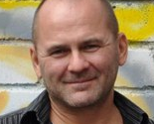
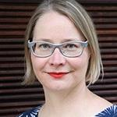
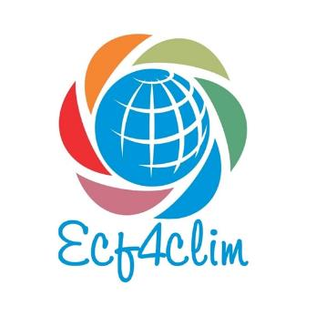
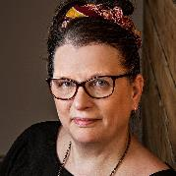
ROADMAP FOR PPROMOTING SUSTAINABILITY IN EDUCATION Team in the Finnish Institute for Educational Research, UNIVERSITY OF JYVÄSKYLÄ
Hannu L. T. Heikkinen
Professor
hannu.l.t.heikkinen@jyu.fi
Terhi Nokkala
Senior Researcher
terhi.p.nokkala@jyu.fi
Niina Mykrä
Post doctoral researcher
niina.p.mykra@jyu.fi
Anna Lehtonen
Post doctoral researcher
anna.e.lehtonen@jyu.fi
Notes:
This was our introduction to roadmap.
Here you can see our contact information.
Thank you and godd luck and courage for promotion sustainability!

